Slide 1
WEB DESIGN

Slide 2
HTML & CSS

Slide 3
STRUCTURE & PRESENTATION

Slide 4
Structure: HTML
<p class='content'>content</p>

Slide 5
Presentation: CSS
p.content { color:"red"; }

Slide 6
GET THE CODE:
https://bit.ly/2T4TF5Q

Slide 7
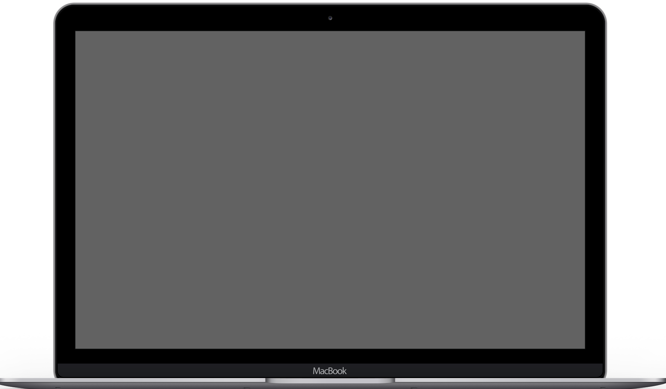

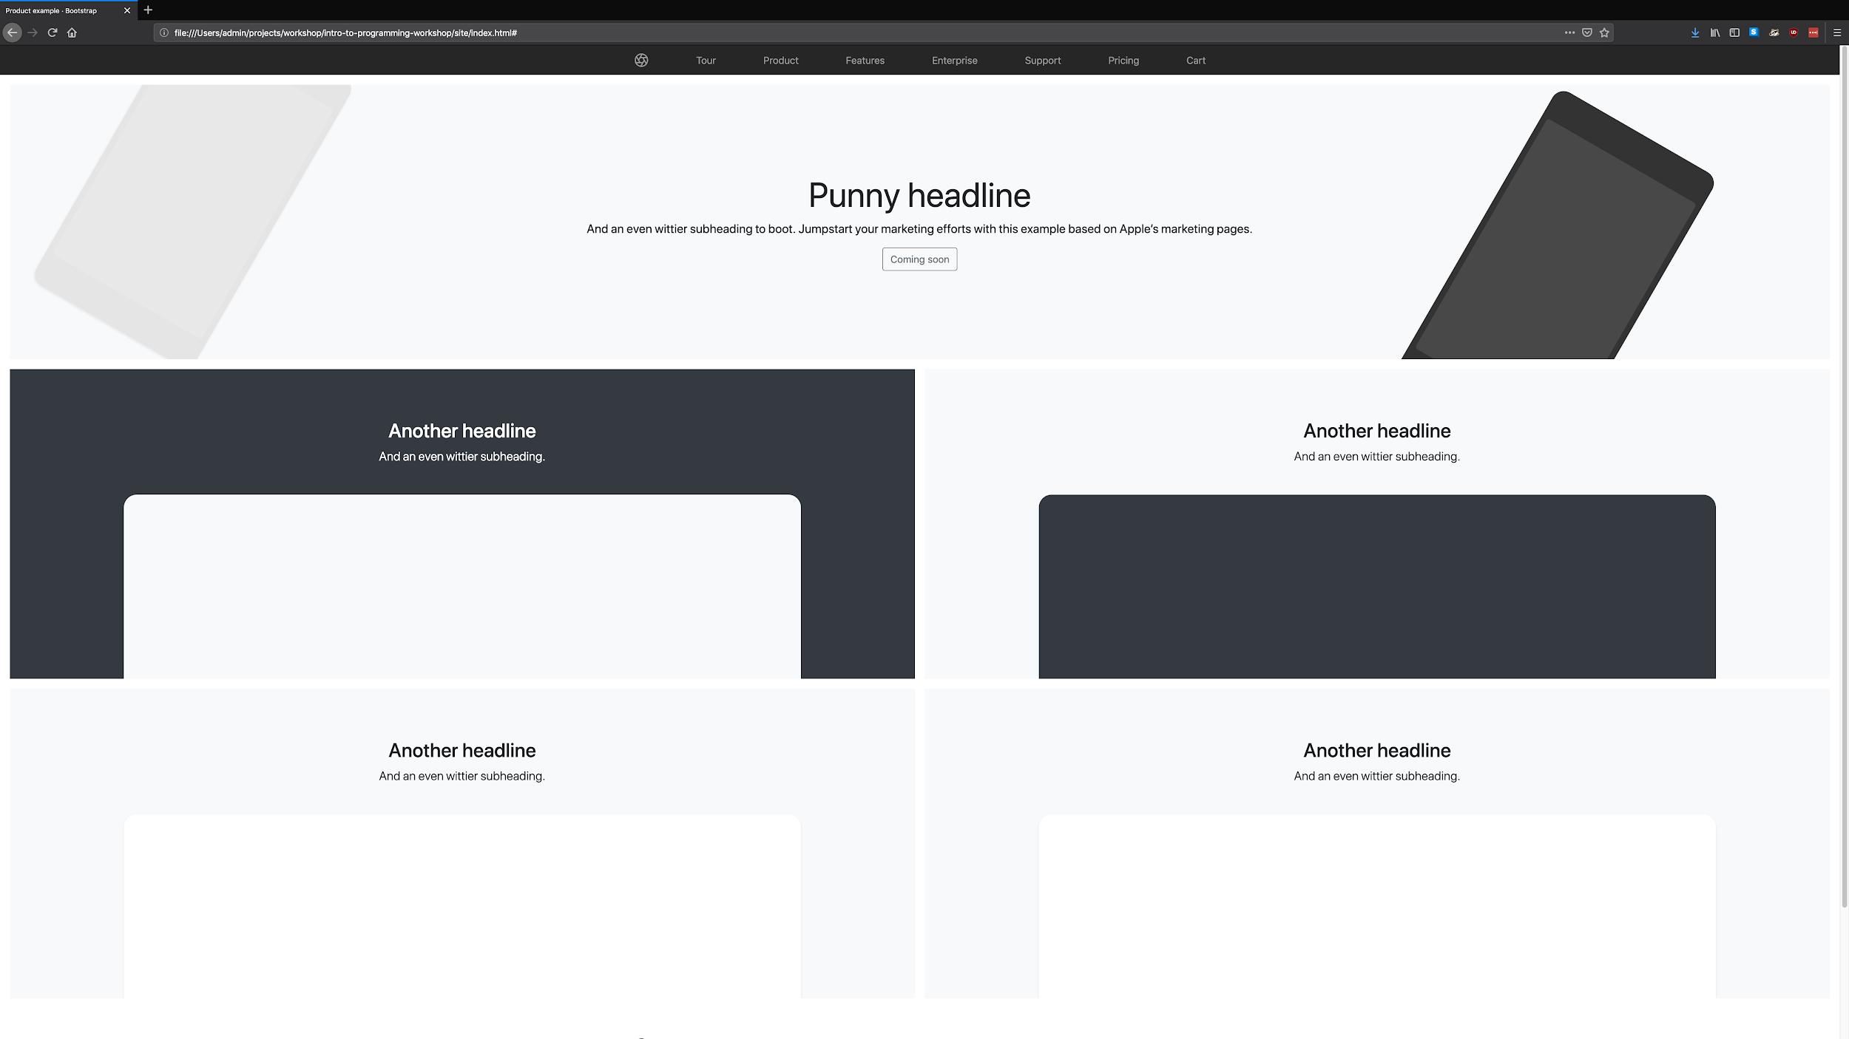
Once you have the code:
Open up the folder in a file explorer
Open site/index.html in a browser
Make a change to product.css
CMD+R (Mac OSX) or SHIFT+F5 (Windows) to refresh the page
See your changes!

Slide 8
SONIC PI
Notes:
What is Sonic Pi? It’s a live-coding environment where you can learn the fundamentals of computer programming.
It has support for functions, variables, live loops and uses a Ruby-like DSL to communicate with a Supercollider server running an Overtone frontend.
Sam Aaron, one of the creators of Overtone, created it at Cambridge University to explore it as a teaching and learning tool for both music and programming, as well as to provide a solid, easy-to-use live coding environment.

Slide 9
“I see software primarily as a form of communication that is not just limited to a conversation between a programmer and the computer, but between many participants, all of whom have an interest in understanding parts of the software.”
Dr. Sam Aaron

Slide 10
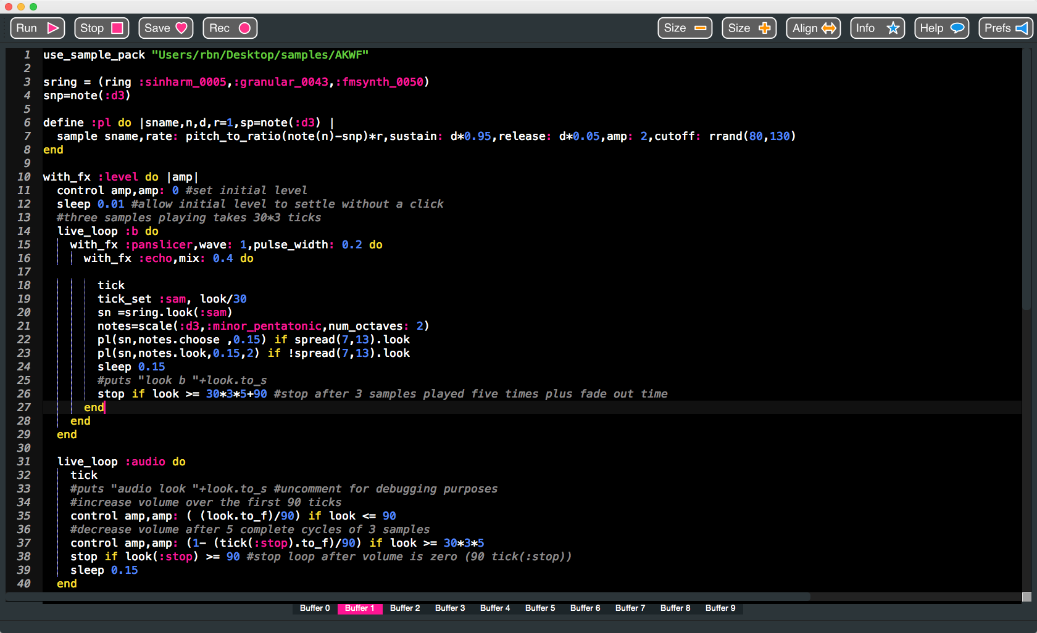
Download and Run Sonic PI
First, go to:
https://sonic-pi.net
Choose your platform
Download the installer
Follow the instructions
Open Sonic Pi when finished
https://sonic-pi.net/tutorial.html

Slide 11
Happy hacking!

